Slide 1

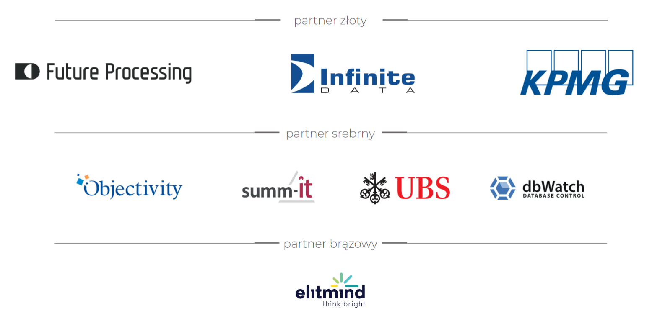

Slide 2

Migrate traditional DW transformations to Spark/Scala
Sergiy Lunyakin

Slide 3




ABOUT ME
Lead Big Data Engineer at Amazon
MS MVP Reconnect
Contacts:
sergey.lunyakin@gmail.com
@slunyakin
Sergiy Lunyakin

Slide 4
This session is …
About DW transformation only
Not about DW design
Not about DW specific approaches (incremental, SCD and etc)

Slide 5
AGENDA
Minimal requirements
Motivation drivers
Main concepts
DW components
Code structure
Transformation
Development process
Testing

Slide 6
Minimal requirements
Total data volume >100GB
Data is constantly growing >20% per month
Support from top management
Weight all Pros/Cons

Slide 7
Motivation drivers
Scalability – scale as data growth with minimum efforts, parallel processing
Provide business new possibilities – collect more data with deeper granularity to show holistic picture
Minimize costs – eliminate licensing, release resources
Agile development – group development, CRs, releases, CI/CD

Slide 8
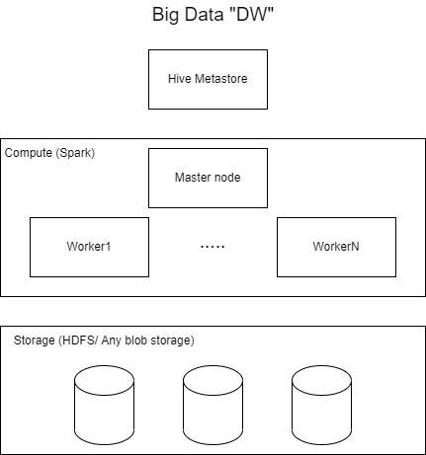
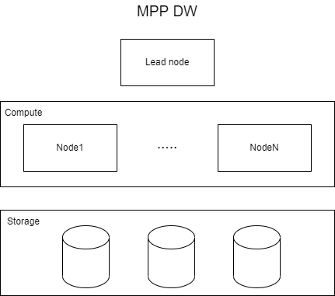
Main concepts - Architecture

Slide 9
Main concepts – DW Components
DW | Big Data “DW”
Table definitions in DB | Table definitions in Hive metastore
Transformations – Stored Procedures, Functions | Methods, Classes compiled into JAR
Storage – internal data format, columnar | Storage – open columnar formats e.g. parquet, orc
Partitioning – tables in internal storage | Partitioning – storage partitioning by prefixes
Compute – scalable engine, always allocated | Compute – scalable engine, allocated on-demand
Coding – SQL-like lang, hard to support and organize team development, CI/CD | Coding – OOP/FP lang, easy for team development, CI/CD

Slide 10
Main concepts – Code structure
Constants – defined constant values e.g. parameter names, filter values
Provides experience similar to RDBMS IntelliSense
Simplify renaming and changes from single place
Can be moved outside of the code
Domain – define table schema, sub-schemas, additional dataset specific structures like partitioning columns
Traits – define templates for classes (domain, parameters, transformations)
Reduce a new code writing
Reduce number of mistakes

Slide 11
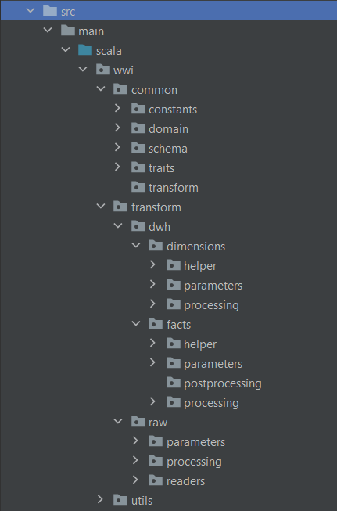
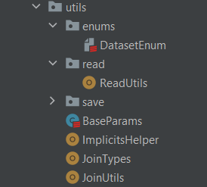
Main concepts – Code structure
Define custom methods to make development similar to SQL
Create Utils classes
UDF for SQL commands missed in DF API
Join specific methods – Left, Right, Inner, AntiJoin and etc
Consolidate Read, Write methods in Utils
Use Polymorphism to simplify code and learning curve

Slide 12
Main concepts – Transformation
Split transformation to meaningful chunks
Structure project
Reduce Spark DAG size
Granular orchestration
Create Helper classes to consolidate transformations
Any small peace of logic === separate method in Helper
Additional aggregation schemas
Easy to cover code with Unit tests
Pipe transformations
Improve readability
Easy code writing

Slide 13
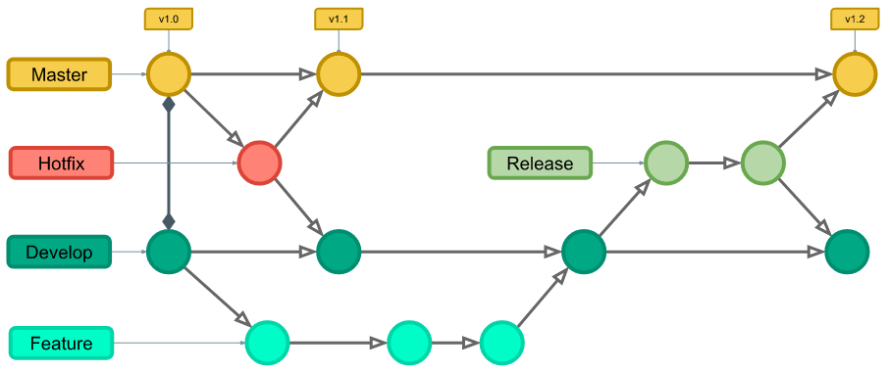
Development process
Use separate branch for every feature development
Easy to isolate development from beta/gamma/prod
Easy to do group development and share code
Easy to organize CI/CD
Setup local env
Spark
Hive
Create Code Review policy
Description template
Check list for reviewer and developer

Slide 14
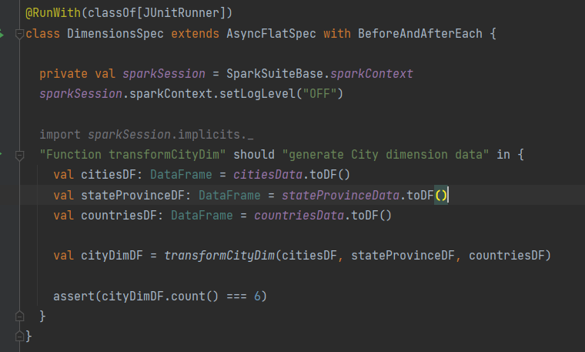
Testing
Use TDD approach
Write test that fails
Write minimum code, test fails
Write full required logic, test passed
Refactor
Unit Testing
Reduce learning curve
Speeds up development
Improves code quality

Slide 15
Summary
Think about your motivation and architecture drivers
Consider minimal requirements and Pros/Cons
Invest in developers – trainings
Use iterative development – write -> refactor1 -> refactor2 ->…

Slide 16
Q&A

Slide 17
Materials
https://github.com/slunyakin/wwiSpark
https://mrpowers.medium.com/
https://sparkbyexamples.com/
http://scalacookbook.com/

